Slide 1

Functions and Dynamic Memory Management Functions
Dr. Murali Krishna Enduri
Department of CSE

Slide 2
C: Why we need Functions
Functions can be used to: decompose large problems, and to reduce program size by creating reusable sections.
A function is a block of organized, reusable code that is used to perform a single, related action.
C programming language gives you built-in functions like printf(), scanf(), strcpy(), strcat(),sqrt(), pow(), etc.
But, you can also create your own functions (User defined Functions).
Lets you name a group of statements, which makes your program easier to read.
Functions make programs smaller by being able to reuse the same code.
Dividing programs into functions allow you to debug sections at a time.
Well defined functions can be used in other programs that you write.

Slide 3
C: Common Built-in Functions
#include <math.h>
sin(x) // radians
cos(x) // radians
tan(x) // radians
atan(x)
atan2(y,x)
exp(x) // e^{x}
log(x) // log_{e} x
log10(x) // log₁₀ x
sqrt(x) // x ≥ 0
pow(x, y) // x^{y}
...
#include <stdio.h>
printf()
fprintf()
scanf()
fscanf()
...
#include <string.h>
strcpy()
strcat()
strcmp()
strlen()
...

Slide 4
C: User Defined Function
Function prototype
Function call
Function Definition

Slide 5
C: Function Definitions
Function definition format
return-value-type function-name( parameter-list ) { declarations and statements }
Function-name: any valid identifier
Return-value-type: data type of the result (default int)
void – indicates that the function returns nothing
Parameter-list: comma separated list, declares parameters
A type must be listed explicitly for each parameter unless, the parameter is of type int
Declarations and statements: function body (block)
Variables can be declared inside blocks (can be nested)
Functions can not be defined inside other functions
Returning control
If nothing returned
return;
or, until reaches right brace
If something returned
return expression;
Example:
int square( int y)
{
return y * y;
}

Slide 6
1 /* Fig. 5.4: fig05_04.c
2 Finding the maximum of three integers */
3 #include <stdio.h>
4
5 int maximum( int, int, int ); /* function prototype */
6
7 int main()
8 {
9 int a, b, c;
10
11 printf( "Enter three integers: " );
12 scanf( "%d%d%d", &a, &b, &c );
13 printf( "Maximum is: %d\n", maximum( a, b, c ) ); /*function Call */ prototype */
14
15 return 0;
16 }
17
18 /* Function maximum definition */
19 int maximum( int x, int y, int z )
20 {
21 int max = x;
22
23 if ( y > max )
24 max = y;
25
26 if ( z > max )
27 max = z;
28
29 return max;
30 }
Enter three integers: 22 85 17
Maximum is: 85

Slide 7
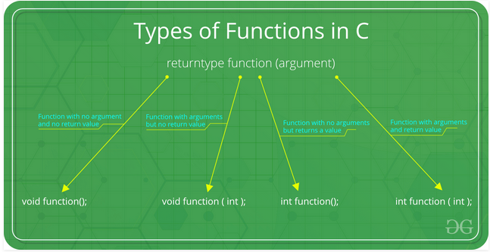
C: type of functions
Function can be divided into 4 categories:
Functions no arguments and no Return Value
Functions Arguments and No Return Value
Functions No Arguments and Return Value
Functions Arguments and Return Value

Slide 8
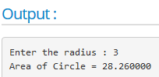
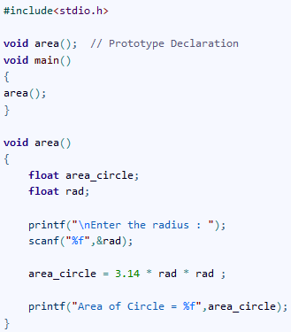
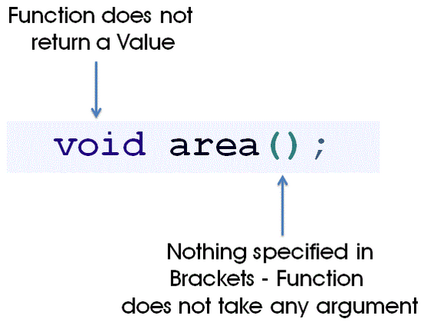
Functions no arguments and no Return Value

Slide 9
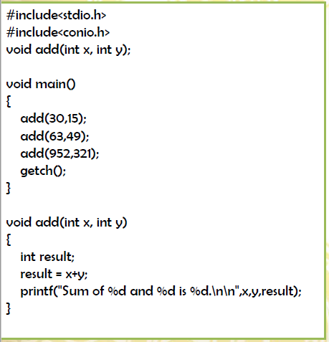
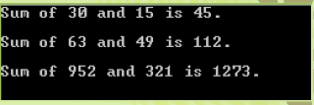
2) Functions Arguments and No Return Value

Slide 10
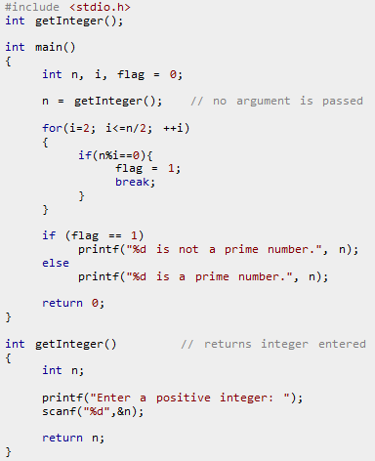
3) Functions No Arguments and Return Value
#include <stdio.h>
int getInteger();
void main()
{
int n, i, flag = 0;
n = getInteger(); // no argument is passed
for(i=2; i<=n/2; ++i){
if(n%i==0){
flag = 1;
break;
}}
if (flag == 1)
printf("%d is not a prime number.", n);
else
printf("%d is a prime number.", n);
}
int getInteger()
{
int n;
printf("Enter a positive integer: ");
scanf("%d",&n);
return n;
}

Slide 11
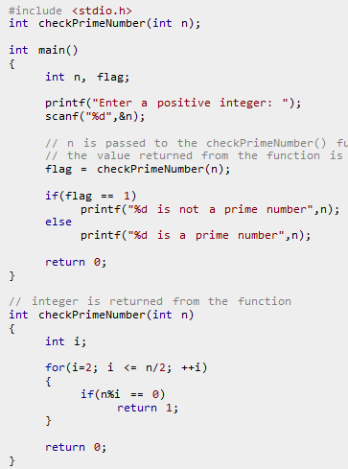
4) Functions Arguments and Return Value

Slide 12
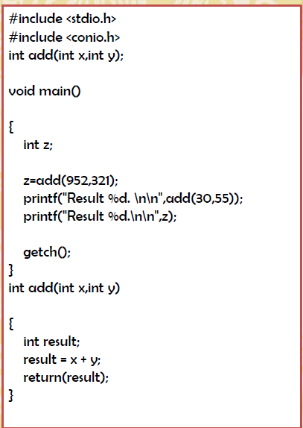

Slide 13
C: Call by value and Call by reference
Call by value
Call by reference
void swap(int a, int b)
{
int temp = a;
a = b;
b = temp;
}
The wrong way to swap
When called with swap(x, y);
x and y will remain the same
void swap(int *a, int *b)
{
int temp = *a;
*a = *b;
*b = temp;
}
The right way to swap
When called with swap(&x, &y); where x and y
are int values, then a points to x and b points
to y, so the values pointed to are swapped,
not the pointers themselves

Slide 14
Call by value
void main()
{
int x=10, y=5;
swap(x,y);
}
swap(int a, int b)
{
int temp;
temp=a;
a=b;
b=temp;
}
10
5
x
y
10
5
a
b

Slide 15
Call by Reference
swap(int *a, int *b)
{
int temp;
temp=*a;
*a=*b;
*b=temp;
}
void main()
{
int x=10, y=5;
swap(&x,&y);
}
1400
10
5
1500
*b
x
y
1400
1500
*a
a
b

Slide 16
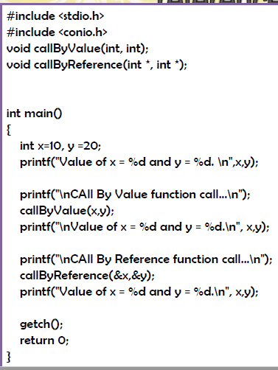
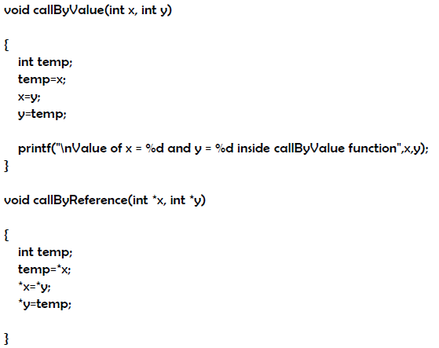
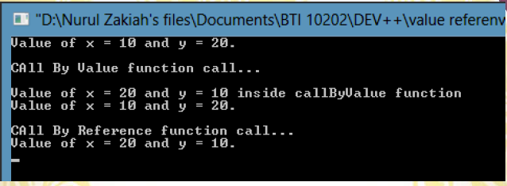

Slide 17
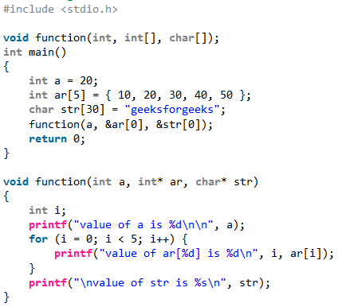
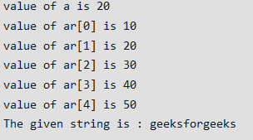

Slide 18
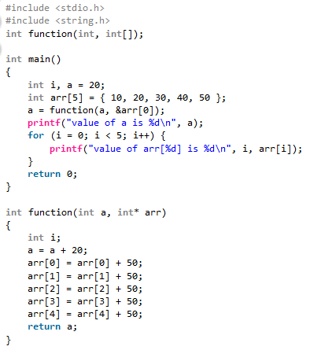
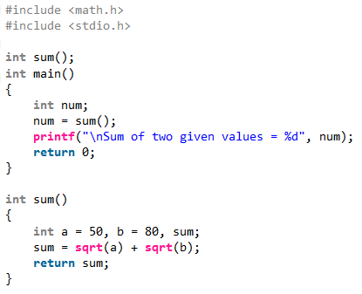

Slide 19
C: Practice problems on functions
Write a function to find the Max of three numbers.
Write a function to calculate the factorial of a number.
Write a function to check whether a number is in a given range.
Given two input number A and B. Find the sum of number between A and B by using function. For example: input: A=2, B=5 output:14 (2+3+4+5).
Write a function to calculate the area of a circle using the formula.
Write a function that prompts user to enter numbers. The process will repeat until user enters 0. Finally, the program prints sum of the numbers entered by the user.
Write a function that takes a number as a parameter and check the number is prime or not.
Write a function to check whether a number is perfect or not.
Write a function to print all Prime numbers between 1 to n.
Write a function to print all Perfect numbers between 1 to n.
Write recursive function to print factorial of number.
Write recursive function to print all factorials between 1 to n.
Write a recursive function to print Fibonacci series up to n terms. example: 0, 1, 1, 2, 3, 5, 8, 13 and so on...
Write a recursion function that finds out the decimal equivalent of the series 1+1/2+1/3+1/4+ ... +1/n.
Write a recursive function to find power of a number.
Write a recursive function count number of digits in a number.

Slide 20
C: Issues with Arrays
Sometimes
Amount of data cannot be predicted beforehand
Number of data items keeps changing during program execution (Static memory allocation)
Example: Search for an element in an array of N elements
One solution: find the maximum possible value of N and allocate an array of N elements
Wasteful of memory space, as N may be much smaller in some executions
Example: maximum value of N may be 10,000, but a particular run may need to search only among 100 elements
Using array of size 10,000 always wastes memory in most cases
Better Solution
Dynamic memory allocation

Slide 21
C: Dynamic Memory Allocation
Dynamic memory allocation is used to obtain and release memory during program execution. Up until this point we reserved memory at compile time using declarations.
You have to be careful with dynamic memory allocation. It operates at a low-level, you will often find yourself having to do a certain amount of work to manage the memory it gives you.
To use the functions discussed here, you must include the stdlib.h header file.
Four Dynamic Memory Allocation Functions:
Allocate memory - malloc(), calloc(), and realloc()
Free memory - free()

Slide 22
C: malloc()
To allocate memory use
void *malloc(size_t size);
Takes number of bytes to allocate as argument.
Use sizeof to determine the size of a type.
Returns pointer of type void *. A void pointer may be assigned to any pointer.
If no memory available, returns NULL.
e.g.
char *line;
int linelength = 100;
line = (char*)malloc(linelength);

Slide 23
C: malloc() example
General format:
type *p;
p = (type *) malloc (byte_size);
p = (int *) malloc(100 * sizeof(int));
A memory space equivalent to 100 times the size of an int bytes is reserved
The address of the first byte of the allocated memory is assigned to the pointer p of type int
p
Note we cast the return value to int*.
Note we also check if the function returns NULL.
400 bytes of space

Slide 24
C: malloc() example
malloc always allocates a block of contiguous bytes
The allocation can fail if sufficient contiguous memory space is not available
If it fails, malloc returns NULL
if ((p = (int *) malloc(100 * sizeof(int))) == NULL)
{
printf (“\n Memory cannot be allocated”);
exit();
}

Slide 25
C: malloc() example
Once the memory is allocated, it can be used with pointers, or with array notation
Example:
int *p, n, i;
scanf(“%d”, &n);
p = (int *) malloc (n * sizeof(int));
for (i=0; i<n; ++i)
scanf(“%d”, p+i);
for (i=0; i<n; ++i)
printf(“%d”, *(p+i));
The n integers allocated can be accessed as *p, *(p+1), *(p+2),…, *(p+n-1) or just as p[0], p[1], p[2], …,p[n-1]

Slide 26
C: free()
To release allocated memory use
free()
De-allocates memory allocated by malloc().
Takes a pointer as an argument.
e.g.
free(newPtr);
Freeing unused memory is a good idea, but it's not mandatory. When your program exits, any memory which it has allocated but not freed will be automatically released.

Slide 27
C: calloc()
Similar to malloc(), the main difference is that the values stored in the allocated memory space are zero by default. With malloc(), the allocated memory could have any value.
calloc() requires two arguments - the number of variables you'd like to allocate memory for and the size of each variable.
void *calloc(size_t nitem, size_t size);
Like malloc(), calloc() will return a void pointer if the memory allocation was successful, else it'll return a NULL pointer.

Slide 28
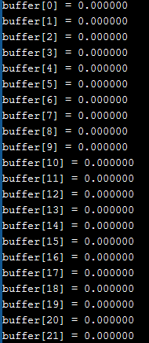
C: calloc() example
/* Using calloc() to initialize 100 floats to 0.0 */
#include <stdlib.h>
#include <stdio.h>
#define BUFFER_SIZE 100
int main(){
float * buffer;
int i;
if ((buffer = (float*)calloc(BUFFER_SIZE, sizeof(float))) == NULL)
{
printf("out of memory\n");
exit(1);
}
for (i=0; i < BUFFER_SIZE; i++)
printf(“buffer[%d] = %f\n”, i, *(buffer+i));
return 0;
}
Output:
Upto
Buffer[99]=0.00000

Slide 29
C: realloc()
If you find you did not allocate enough space use realloc().
You give realloc() a pointer (such as you received from an initial call to malloc()) and a new size, and realloc does what it can to give you a block of memory big enough to hold the new size.
int *ip;
ip = (int*)malloc(100 * sizeof(int));
...
/* need twice as much space */
ip = (int*)realloc(ip, 200 * sizeof(int));

Slide 30
malloc
Allocates requested number of bytes and returns a pointer to the first byte of the allocated space
calloc
Allocates space for an array of elements, initializes them to zero and then returns a pointer to the memory.
free
Frees previously allocated space.
realloc
Modifies the size of previously allocated space.
We will only do malloc and free

Slide 31
Example
#include<stdio.h>
#include<stdlib.h>
int main()
{
int i,N;
float *height;
float sum=0.0,avg;
printf("Input no. of students\n");
scanf("%d", &N);
height=(float *)malloc(N *sizeof(float));
printf("Input heights for %d students \n",N);
for(i=0; i<N; i++)
scanf("%f",height+i);
for(i=0;i<N;i++)
sum += *(height+i);
avg=sum/N;
printf("Average height = %f \n",avg);
free(height);
return 0;
}

Slide 32
C: Practice problems on Arrays and strings using functions
Write a C program to input and print array elements using functions.
Write a C program to copy one array to another using functions.
Write a C program to swap two arrays using functions.
Write a C program to reverse an array using functions.
Write a C program to search an element in array using functions.
Write a C program to find maximum element in array using functions.
Write a C program to find length of string using functions.
Write a C program to copy one string to another using functions.
Write a C program to concatenate two strings using functions.
Write a C program to compare two strings using functions.
Write a C program to find reverse of a string using functions.

